Slide 1
RIP v1 Routing
CCNA Exploration Semester 2
Chapter 5
S Ward Abingdon and Witney College
Notes:
RIP1.ppt
S Ward Abingdon and Witney College

Slide 2
Topics
Functions, characteristics and operation of RIP v1
Configure a device for RIP v1
Verify RIP v1 operation
Automatic summarization with RIP
Propagating default routes
Troubleshooting RIP problems
S Ward Abingdon and Witney College

Slide 3
Routing protocols
Interior
Exterior
Distance vector
Link state
RIP v1
RIP v2
IGRP
EIGRP
OSPF
IS-IS
EGP
BGP
S Ward Abingdon and Witney College

Slide 4
RIP development
Early 1970s to 1980s: early development (Xerox PARC) and different versions.
1988: Standardised as RFC 1058
1994: RIP version 2 as RFC 1723
1997: RIPng for IP version 6 as RFC 2080
S Ward Abingdon and Witney College

Slide 5
RIP v 1 reminder
Distance vector routing protocol
Broadcasts updates every 30 seconds by default
Hop count is the only metric, maximum 15
Hop count of 16 means unreachable, regarded as “infinity”
S Ward Abingdon and Witney College

Slide 6
Encapsulation
RIP updates are encapsulated inside UDP segments.
Speed and low overhead are more important than reliability.
Up to 25 routes can be carried in one message
S Ward Abingdon and Witney College

Slide 7
RIP message types
Request – sent out when RIP routing starts up
Response – reply to request
Startup router builds its table then sends triggered update
Then updates sent at regular intervals
S Ward Abingdon and Witney College

Slide 8
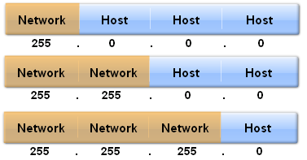
IP address Classes
Class A
1 to 126
Class B
128 to 191
Class C
192 to 223
S Ward Abingdon and Witney College

Slide 9
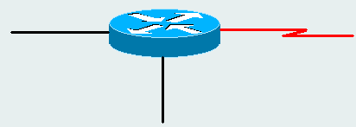
Classful
172.16.0.1/24
RIP 1 does not send subnet masks in updates
Assumes that subnet mask is class default or the same as the mask on its interfaces
Learns 192.168.2.0, assumes /24
Learns 172.18.0.0,
assumes /16
Learns 10.0.0.0,
assumes /8
S Ward Abingdon and Witney College

Slide 10
Configure RIP
Ab(config)#router rip
Ab(config-router)#network 192.168.1.0
Ab(config-router)#network 192.168.2.0
Ab(config-router)#exit
Enter router configuration mode
List the directly connected networks to be advertised
S Ward Abingdon and Witney College

Slide 11
Network command
The network command is needed to:
Enable routing updates to be sent through the interface connected to that network
Allow updates about that network to be sent.
List only networks that are directly connected.
If you specify a subnet address then the router will substitute the main network address.
S Ward Abingdon and Witney College

Slide 12
Troubleshooting
Check that interfaces are up and addresses correct with show ip interface brief
Show ip route for routing table, check for missing routes
Show ip protocols for routing protocol version, interfaces sending, networks etc.
Debug ip rip to watch updates being sent and received
S Ward Abingdon and Witney College

Slide 13
Routing table
Remote network
Mask used
Administrative distance and metric
RIP used
R 192.168.5.0/24 [120/2] via 192.168.2.2, 00:00:23, Serial0/0
Next hop address
Time since last update
Outgoing interface
S Ward Abingdon and Witney College

Slide 14
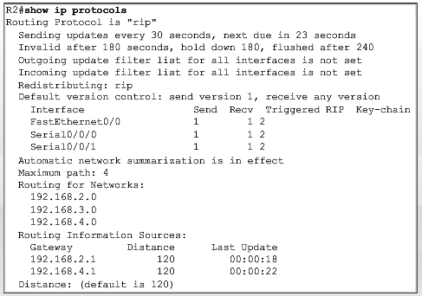
Show ip protocols
RIP is working
S Ward Abingdon and Witney College

Slide 15
Show ip protocols
RIP timers: update, invalid, holddown, flush
S Ward Abingdon and Witney College

Slide 16
Show ip protocols
Redistributing RIP
No other routing protocol
S Ward Abingdon and Witney College

Slide 17
Show ip protocols
Version
Send v1
Receive any version
S Ward Abingdon and Witney College

Slide 18
Show ip protocols
Interfaces sending and receiving, which version
S Ward Abingdon and Witney College

Slide 19
Show ip protocols
Automatic network summariz-ation:
Uses class boundaries
S Ward Abingdon and Witney College

Slide 20
Show ip protocols
Maximum path 4
Can load balance on 4 routes
S Ward Abingdon and Witney College

Slide 21
Show ip protocols
List of networks configured with network statement
S Ward Abingdon and Witney College

Slide 22
Show ip protocols
Sources, where information came from and last update
S Ward Abingdon and Witney College

Slide 23
Show ip protocols
Administrative distance is default 120
S Ward Abingdon and Witney College

Slide 24

Debug ip rip
Watch it receive updates
Send and build updates
Remember to turn it off with undebug all or no debug all
S Ward Abingdon and Witney College

Slide 25
Passive interface
Turn off routing updates through interfaces where there are no routers to receive them.
Router(config-router)#passive-interface Fa0/0
Network command is still there so the network will still be advertised.
Saves bandwidth, saves processing by hosts.
Security – no updates to be detected by sniffer.
S Ward Abingdon and Witney College

Slide 26
Automatic summarization
Suppose that the 172.30.0.0/16 network is subnetted into three subnets:
172.30.1.0/24
172.30.2.0/24
172.30.3.0/24
If you enter these as separate networks they will be summarized as 172.30.0.0 since 172… is class B.
S Ward Abingdon and Witney College

Slide 27
Use class boundaries for RIP v1
RtA(config)#router rip
RtA(config-router)#network 172.30.0.0
RtA(config-router)#network 192.168.4.0
RtA(config)#router rip
RtA(config-router)#network 172.30.1.0
RtA(config-router)#network 192.168.4.32
S Ward Abingdon and Witney College

Slide 28

RIP v1 and subnets
If a routing update and the interface on which it is received belong to the same major network, the subnet mask of the interface is applied to the network in the routing update.
172.30.1.0
172.30.2.0/24
Router knows 172.30.2.0 has /24 from interface configuration.
Treats 172.30.1.0 as /24 as well.
S Ward Abingdon and Witney College

Slide 29
RIP v1 and subnets
If a routing update and the interface on which it is received belong to different major networks, the classful subnet mask of the network is applied to the network in the routing update.
172.30.1.0
172.16.1.0/24
172.30.1.0 is on a different major network from 172.16.1.0. Subnetting not recognised. Treated as 172.30.0.0.
S Ward Abingdon and Witney College

Slide 30
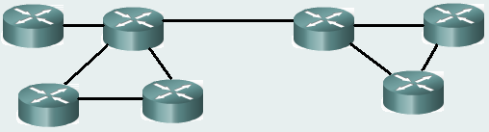
Automatic summarisation
All subnets of
192.168.1.0/24
192.168.1.0/27
192.168.1.32/27
192.168.1.64/27 etc.
All subnets of 172.16.0.0/16
172.16.1.0/24
172.16.2.0/24
172.16.3.0/24
etc.
Border router summarizes to class boundary
S Ward Abingdon and Witney College

Slide 31
Automatic summarization
Advantages:
Smaller routing updates sent and received.
Smaller routing table gives faster lookup.
As long as subnetted networks are all contiguous (connected together with no other networks in between) then routers should find the right paths.
S Ward Abingdon and Witney College

Slide 32
Discontiguous networks
172.16.1.0/24
192.168.1.0/24
172.16.2.0/24
A
B
172.16.1.0/24 and 172.16.2.0/24 are subnets of the same major network, but they are discontiguous.
A will not forward any packets for 172.16.0.0 via B so packets for 172.16.2.0 are lost.
S Ward Abingdon and Witney College

Slide 33
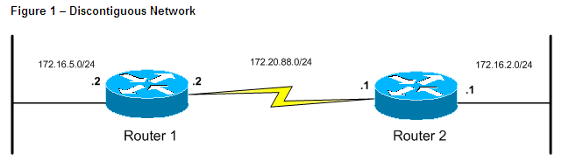
Another Example
Background Information
RIP and IGRP are classful protocols. Whenever RIP advertises a network across a different major net boundary, RIP summarizes the advertised network at the major net boundary.
In Figure 1, when Router 1 sends an update that contains 172.16.5.0 to Router 2 across 172.20.88.0, the router converts 172.16.5.0/24 into 172.16.0.0/16. This process is called auto-summarization.
S Ward Abingdon and Witney College

Slide 34
When Router 1 Sends an Update to Router 2
Here is the question you need to answer:
Is 172.16.5.0/24 part of the same major network as 172.20.88.0/24, which is the network assigned to the interface that sources the update?
  No: Router 1 summarizes 172.16.5.0/24 and advertises the route 172.16.0.0/16. The summarization is done to the major classful boundary. In this case, the address is a class B address, and so, the summary is 16 bits.
  Yes: Although this is not the case in the example, if the answer to the question is yes, Router 1 would not summarize the network and would advertise the network with subnet information intact.
S Ward Abingdon and Witney College

Slide 35
Router 2 Receives updates from Router 1
When Router 2 prepares to receive and update from Router 1, you need to identify the questions that need to be answered.
Again, remember that the reception of network 172.16.5.0/24 is of interest here.
However, remember that when Router 1 sent the update the network was summarized to 172.16.0.0/16. Here is the question you need to answer:
Is the network that receives updates (172.16.0.0/16) part of the same major network of 172.20.88.0, which is the address assigned to the interface that received the update?
  No: Do any subnets of this major network already exist in the routing table known from interfaces other than that which received the update?
  Yes: Ignore the update.
S Ward Abingdon and Witney College

Slide 36
Debugging
Use the debug ip rip command on Router 2 to see the updates that came in from Router 1:
RIP: received v1 update from 172.20.88.2 on Serial2/0 172.16.0.0 in 1 hops
However, the routing table of Router 2 indicates that the update was ignored. The only entry for any subnetwork or network on 172.16.0.0 is the one directly connected to Ethernet0.
The output of the show ip route command on Router 2 shows:
172.20.0.0/24 is subnetted, 1 subnets
C 172.20.88.0 is directly connected, Serial2/0 172.16.0.0/24 is subnetted, 1 subnets
C 172.16.2.0 is directly connected, Ethernet0/0
S Ward Abingdon and Witney College

Slide 37
Conclusion
The behavior of RIPv1 and IGRP is such that when Router 1 and Router 2 exchange updates, both Router 1 and Router 2 do not learn about the attached subnetworks of 172.16.5.0/24 and 172.16.2.0/24.
As a result, devices on these two subnetworks are unable to communicate with each other.
S Ward Abingdon and Witney College

Slide 38
Solution
Solution
In some situations, discontiguous networks are unavoidable. In these situations Cisco recommends that you do not use RIPv1 or IGRP. Routing protocols like EIGRP or OSPF are better suited for this situation.
Establish Connectivity
In the event that you use RIPv1 or IGRP with discontiguous networks, you must use static routes to establish connectivity between the discontiguous subnetworks. In this example these static routes establish this connectivity:
S Ward Abingdon and Witney College

Slide 39

Connecting to ISP
Static route
Default route
Customer
ISP
No routing protocol configured
Default route to ISP
ISP has static route to customer network(s)
S Ward Abingdon and Witney College

Slide 40
Propagate default route
All customer’s routers need a default route via the ISP
Configure this route on the router connected to the ISP
Propagate to the other routers using:
default-information originate
Command at router configuration prompt.
S Ward Abingdon and Witney College

Slide 41
The End
S Ward Abingdon and Witney College

